Slide 1
March 10th, 2021
In the process of preparing the EGPGV major revision.
Generated new FTLE images to compare against the ground truth in each case.
Coal to Carbon Fiber
Had a meeting with Joshua/Giorgio/Duong
Parallel Coordinates Plot using some of the data in excel sheets.

Slide 2
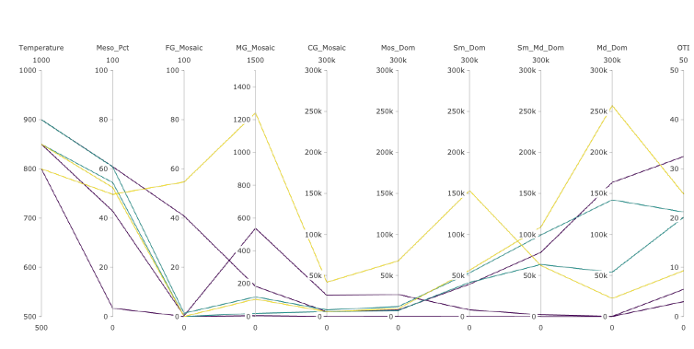

Slide 3
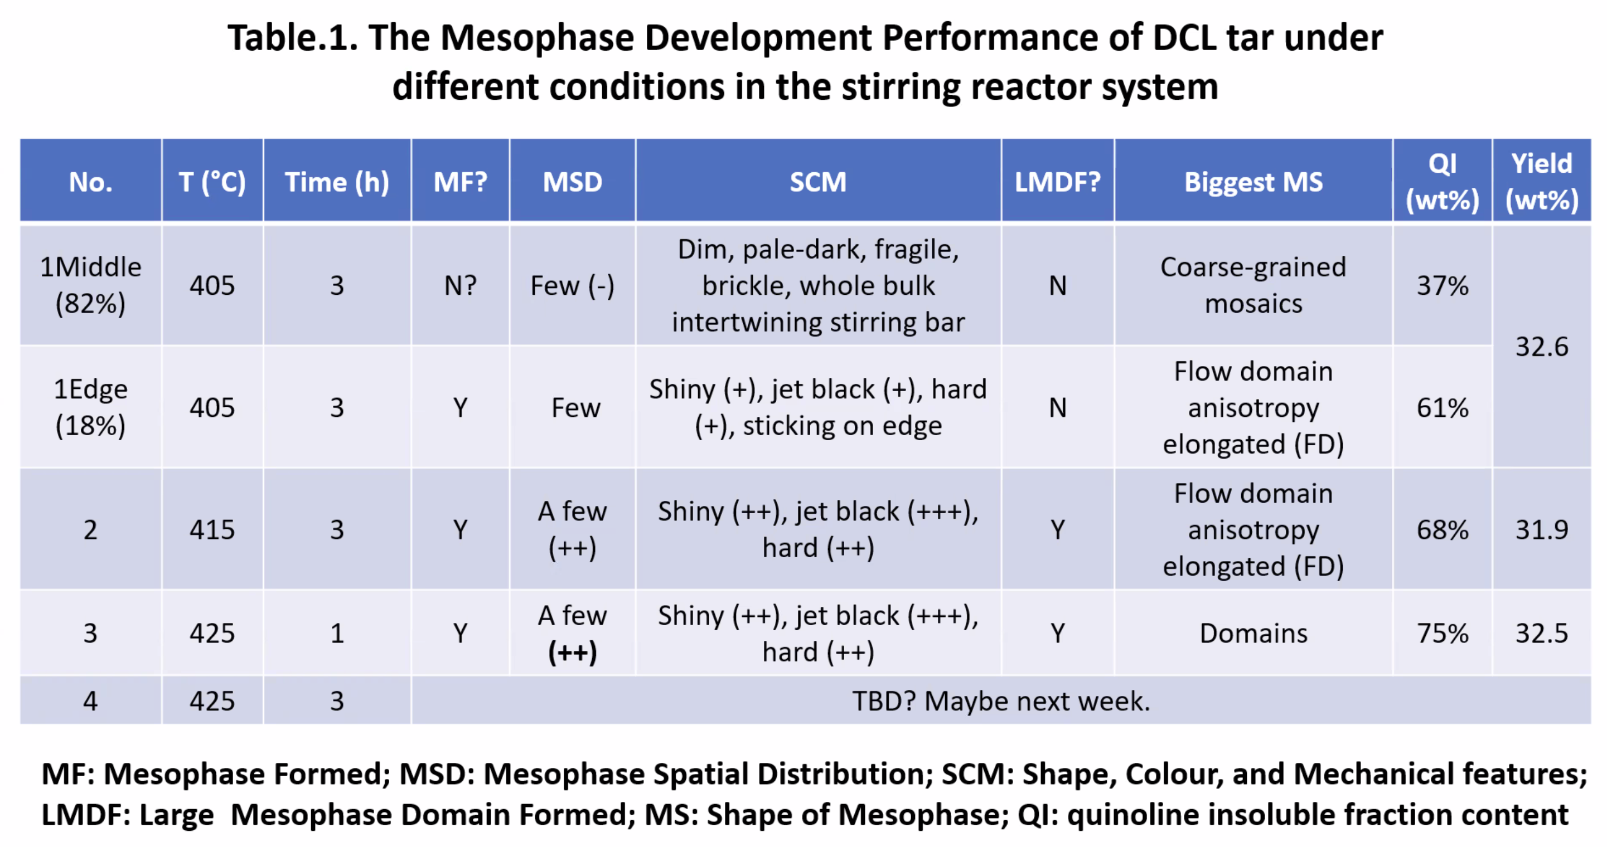

Slide 4
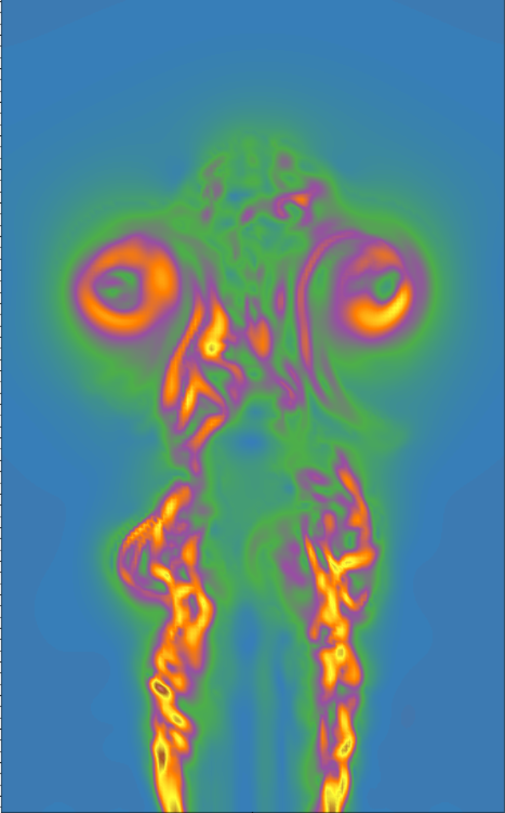
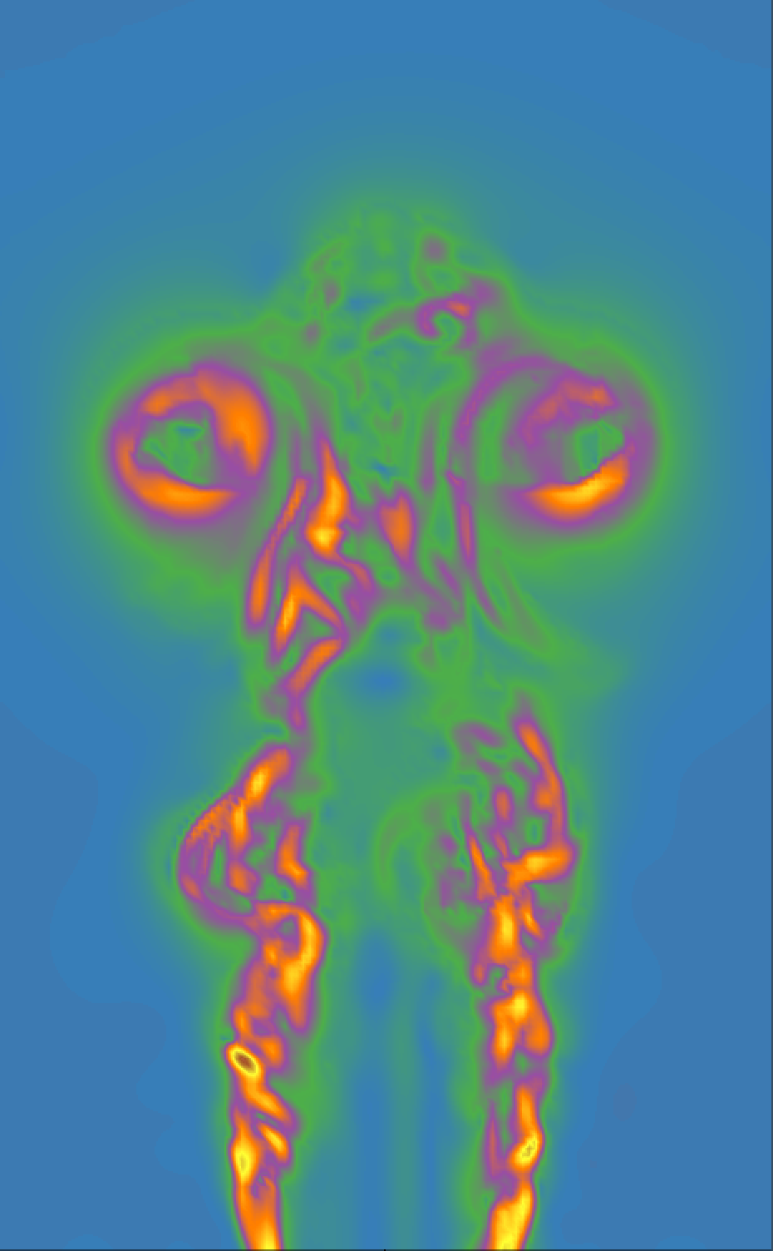
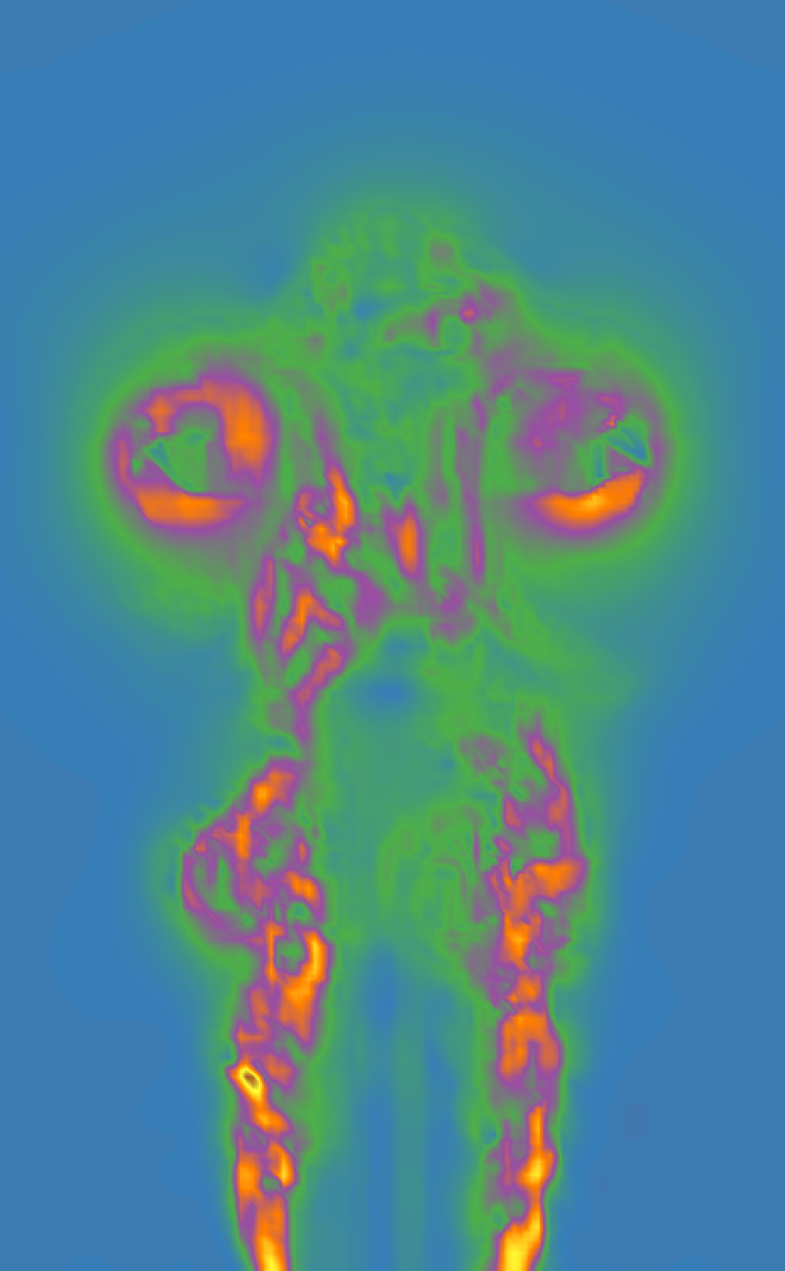
(a) Ground truth
(b) T1, 1:1
(c) T3, 1:8

Slide 5
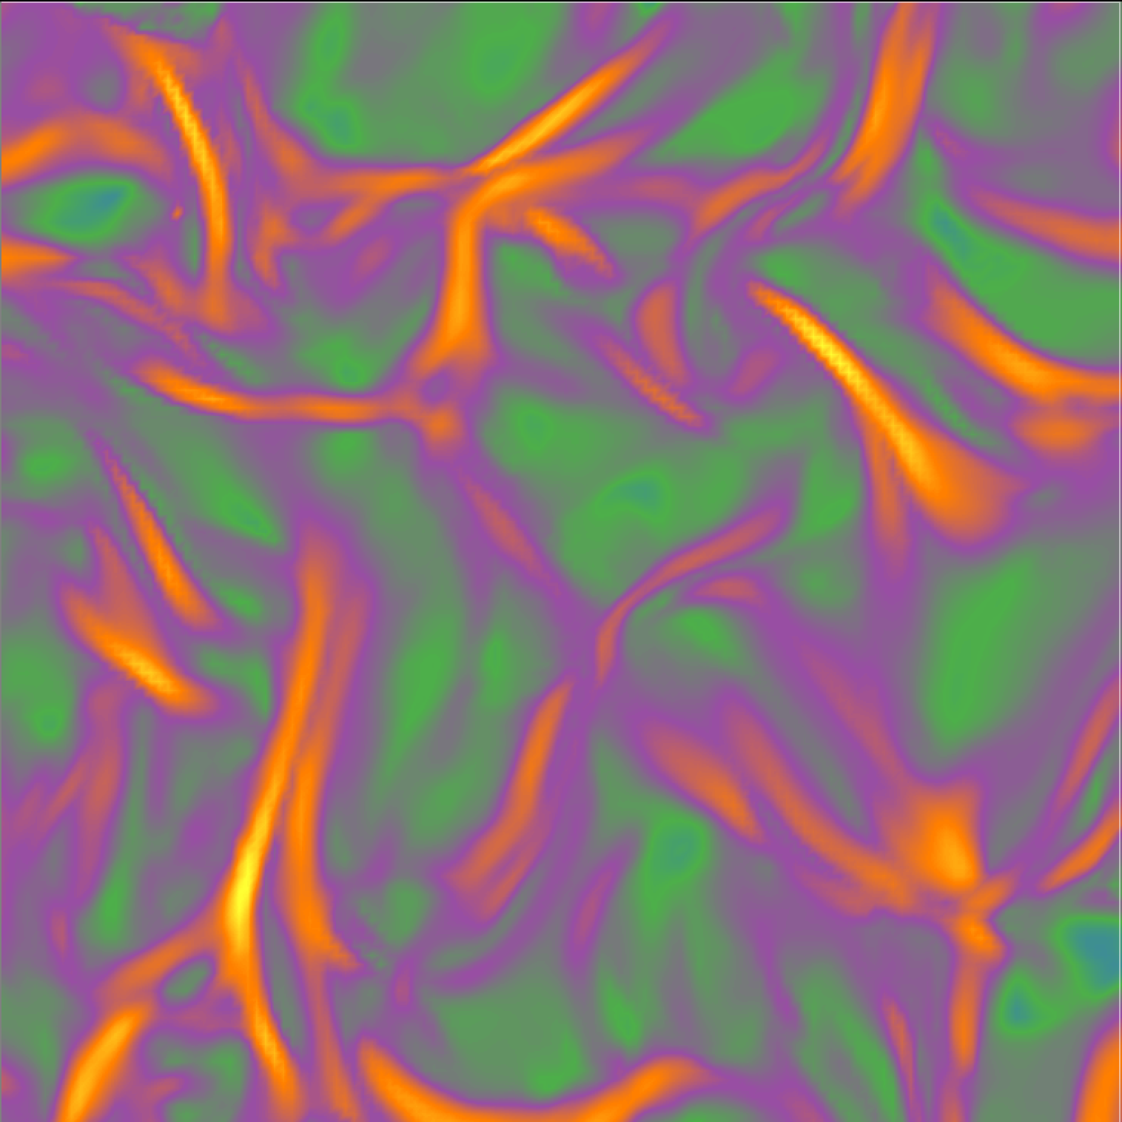
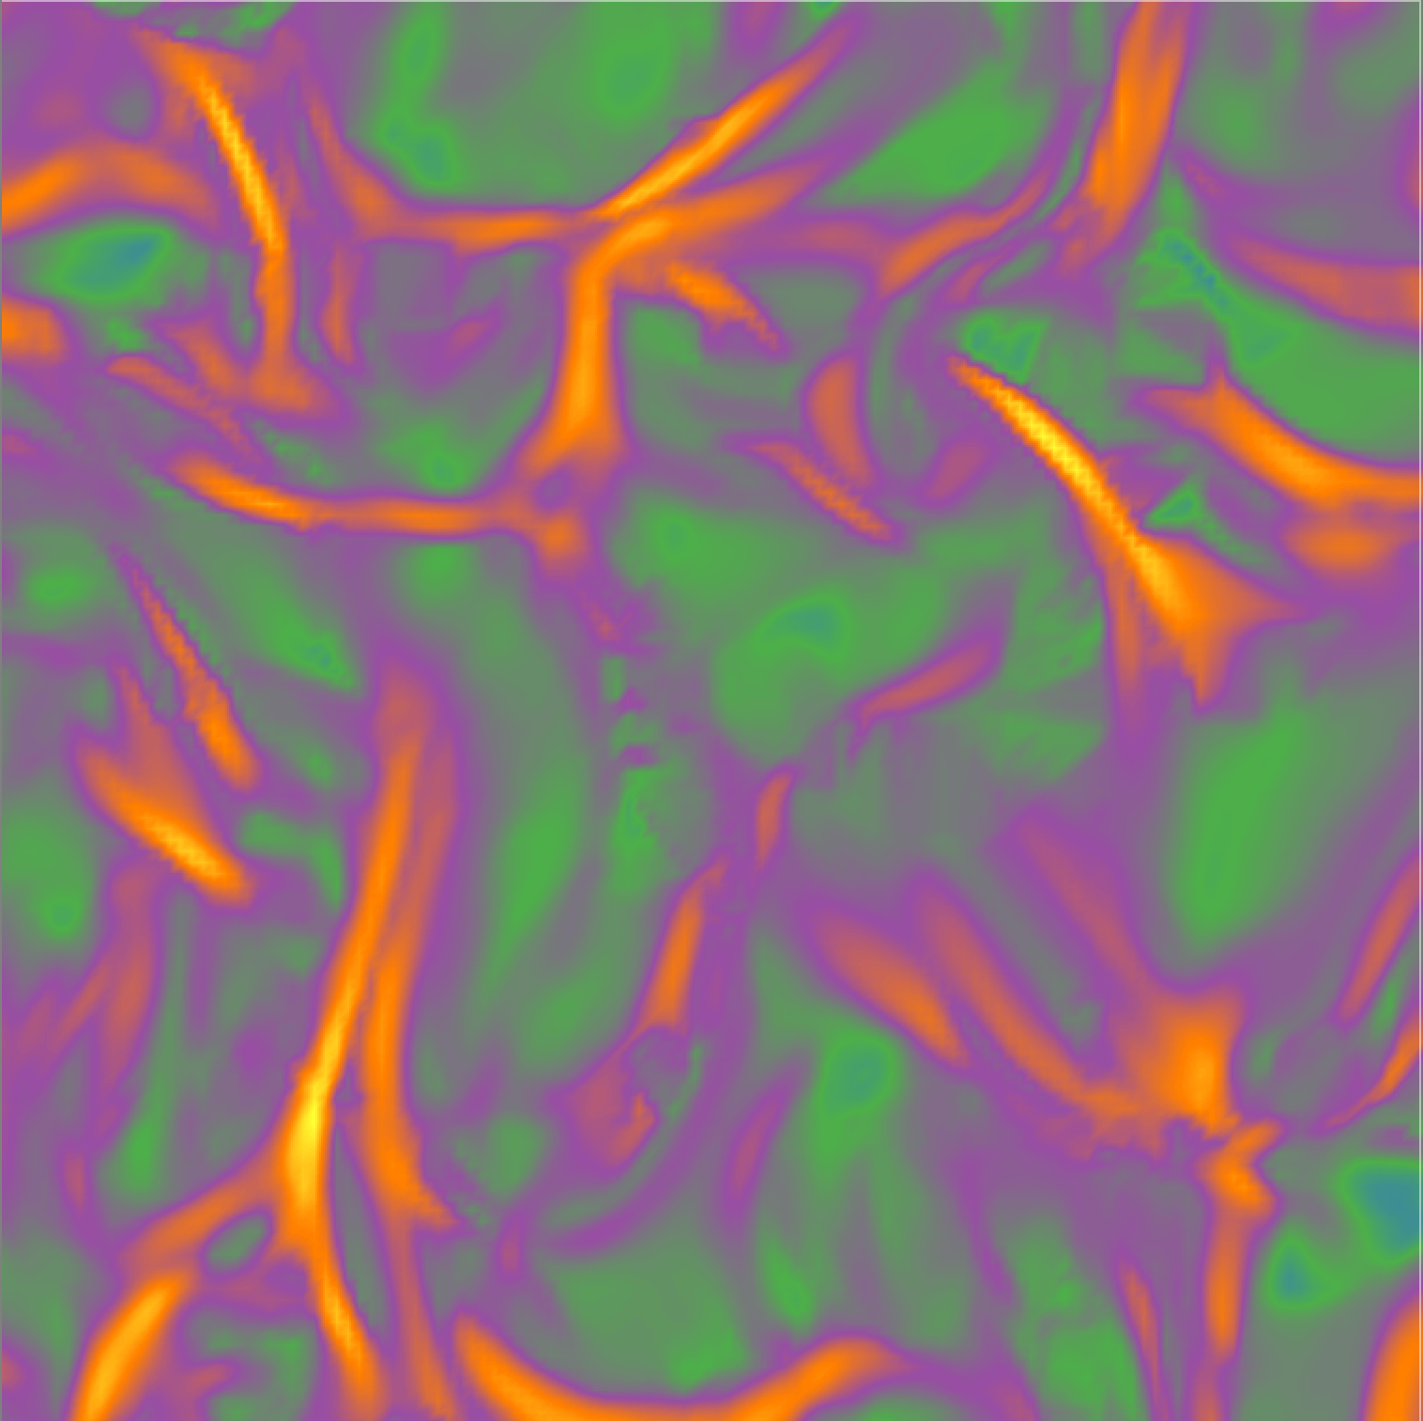
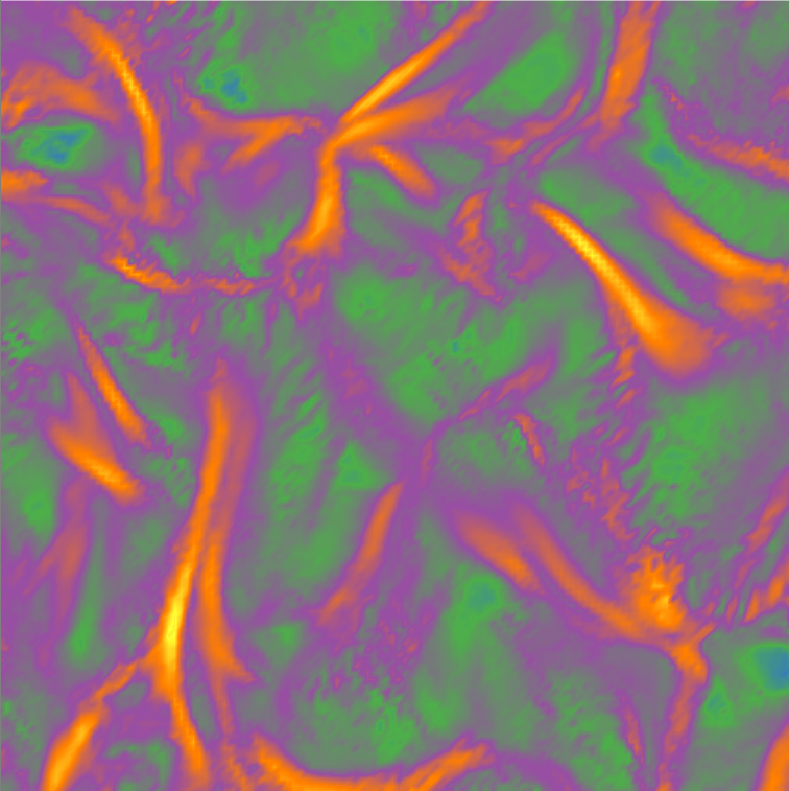
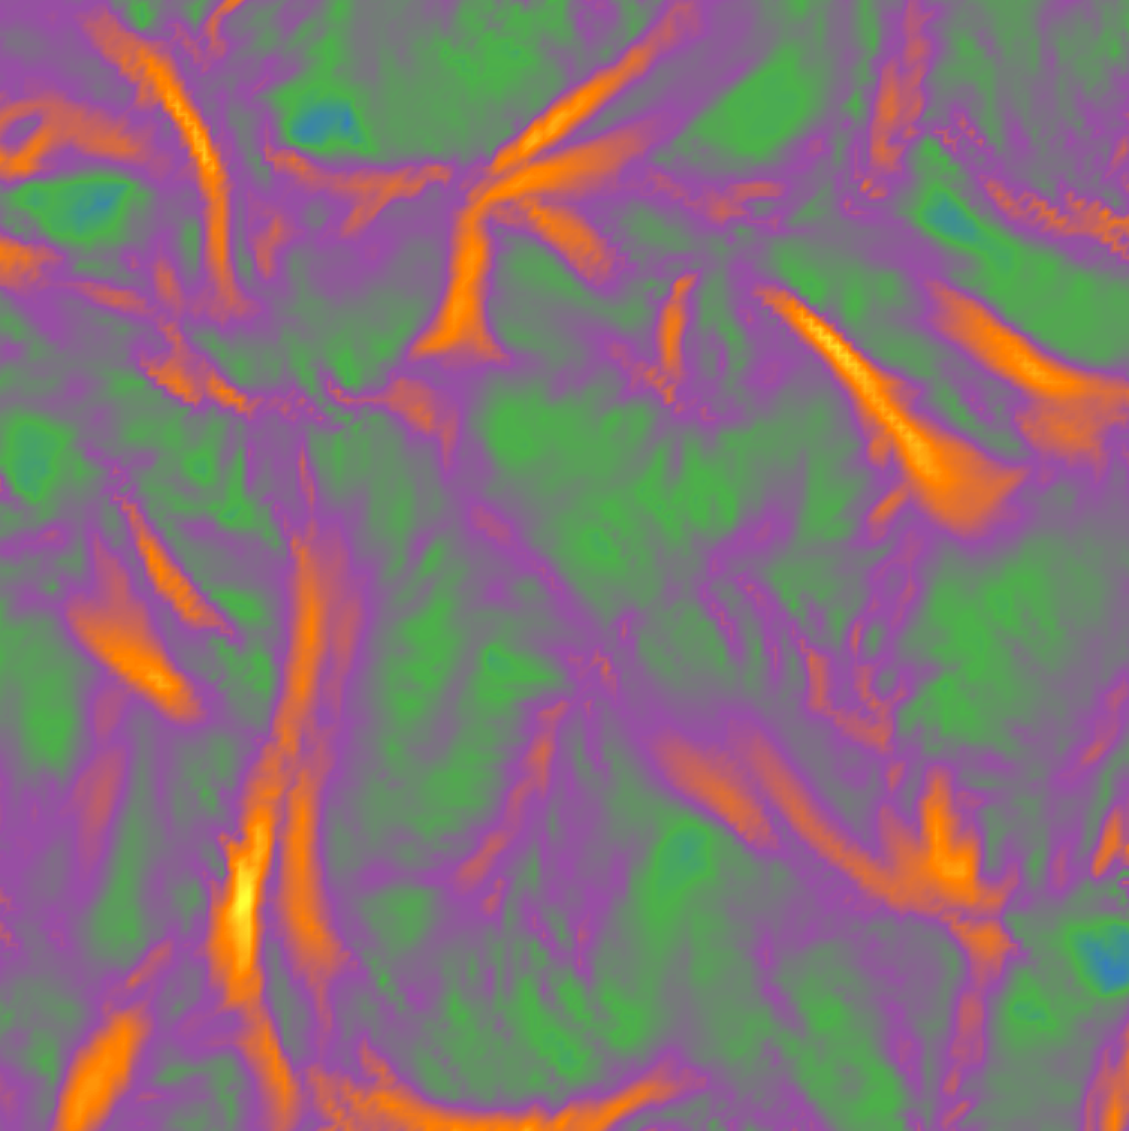
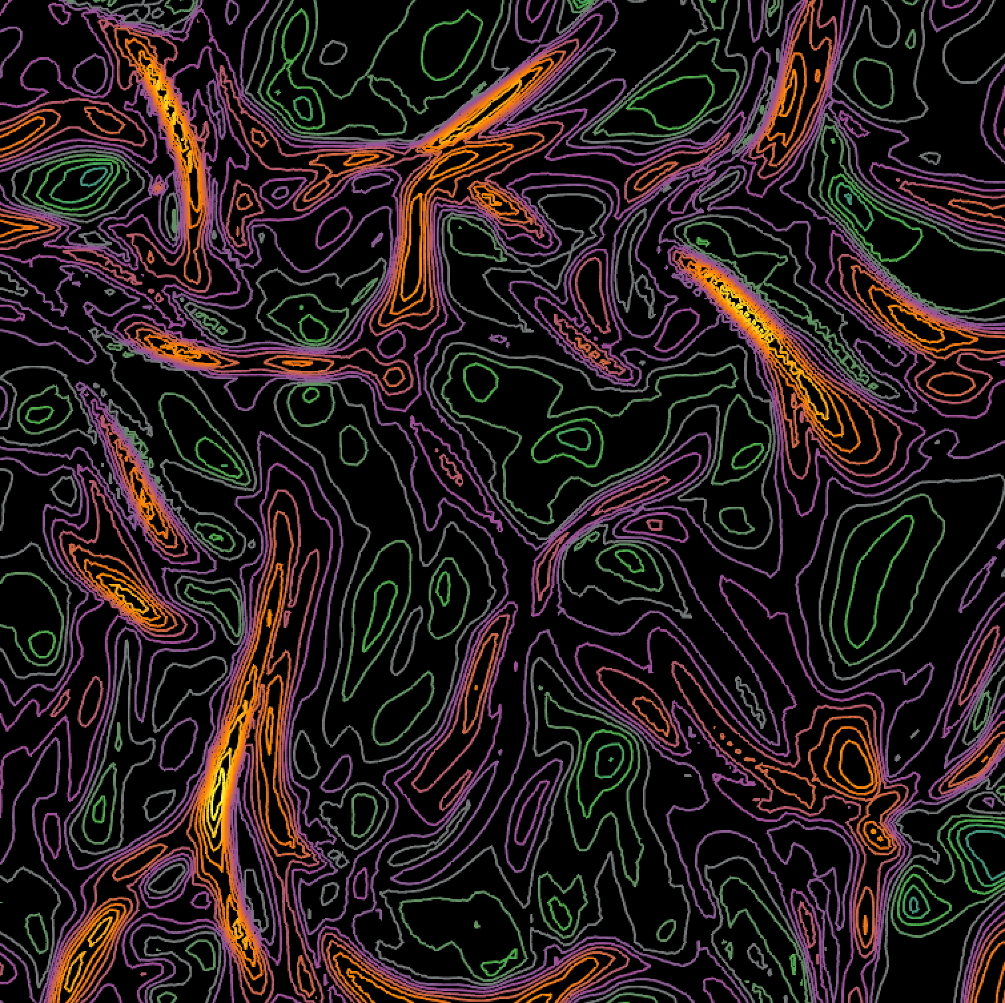
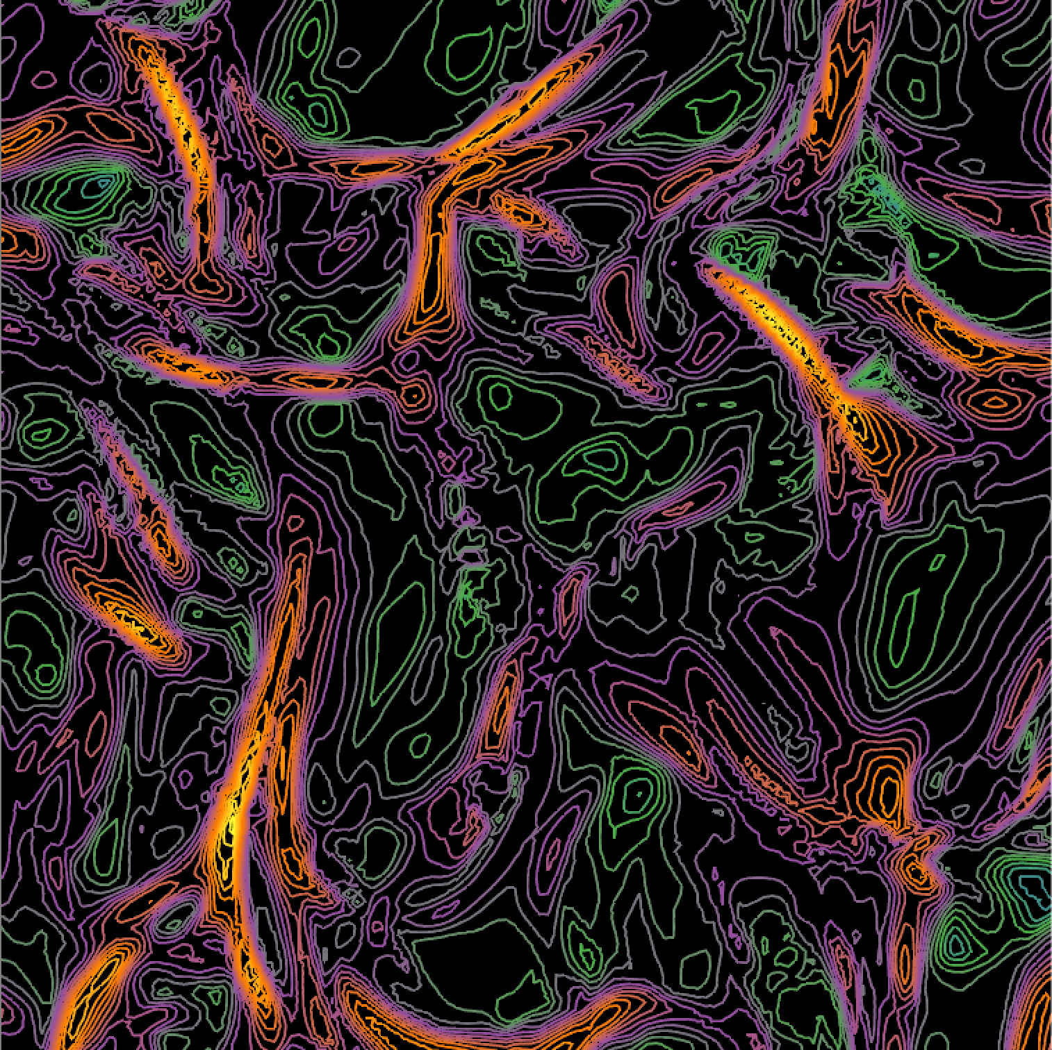
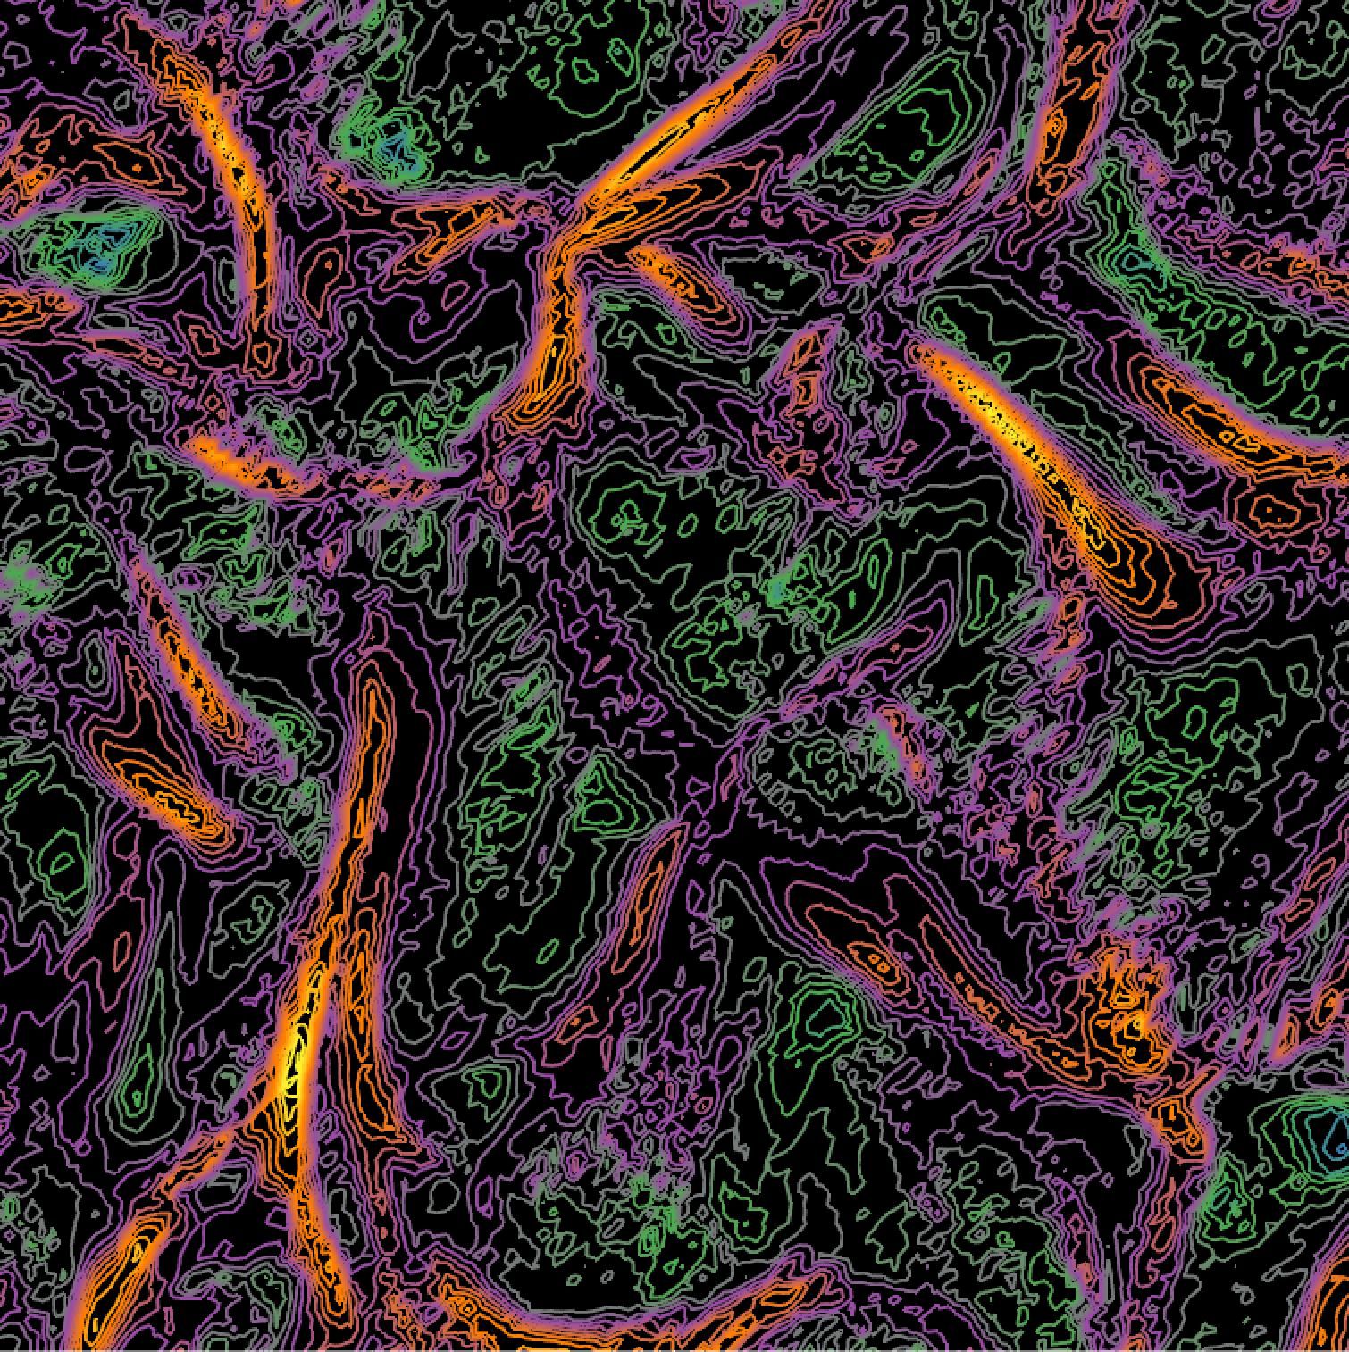
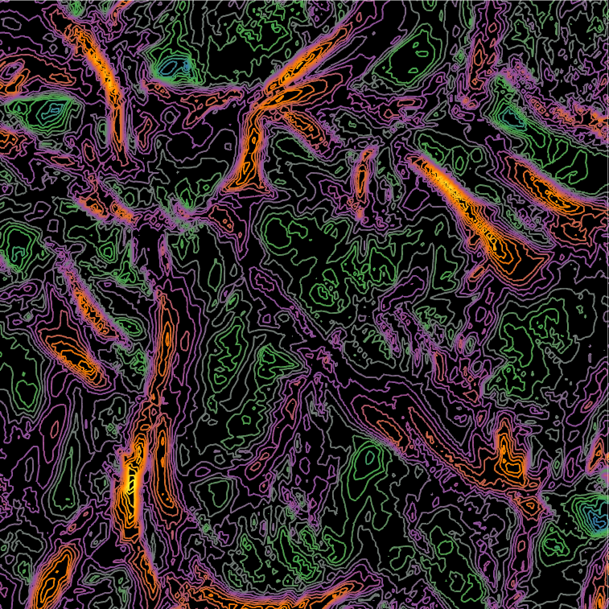
(a) Ground truth, 40 cycles
(b) T3, 1:1, Interval = 40
(c) T1, 1:1, Interval = 10
(d) T5, 1:8, Interval = 10
(e) Ground truth, 40 cycles
(f) T3, 1:1, Interval = 40
(g) T1, 1:1, Interval = 10
(h) T5, 1:8, Interval = 10

Slide 6
(a) Ground truth, 40 cycles
(b) T3, 1:1, Interval = 40
(c) T1, 1:1, Interval = 10
(d) Ground truth, 40 cycles
(e) T3, 1:1, Interval = 40
(f) T1, 1:1, Interval = 10

Slide 7
Ground truth,
40 cycles
(b) T3, 1:1, Interval = 40
(1 interval interpolated)
(c) T1, 1:1, Interval = 10
(4 intervals interpolated)

Slide 8
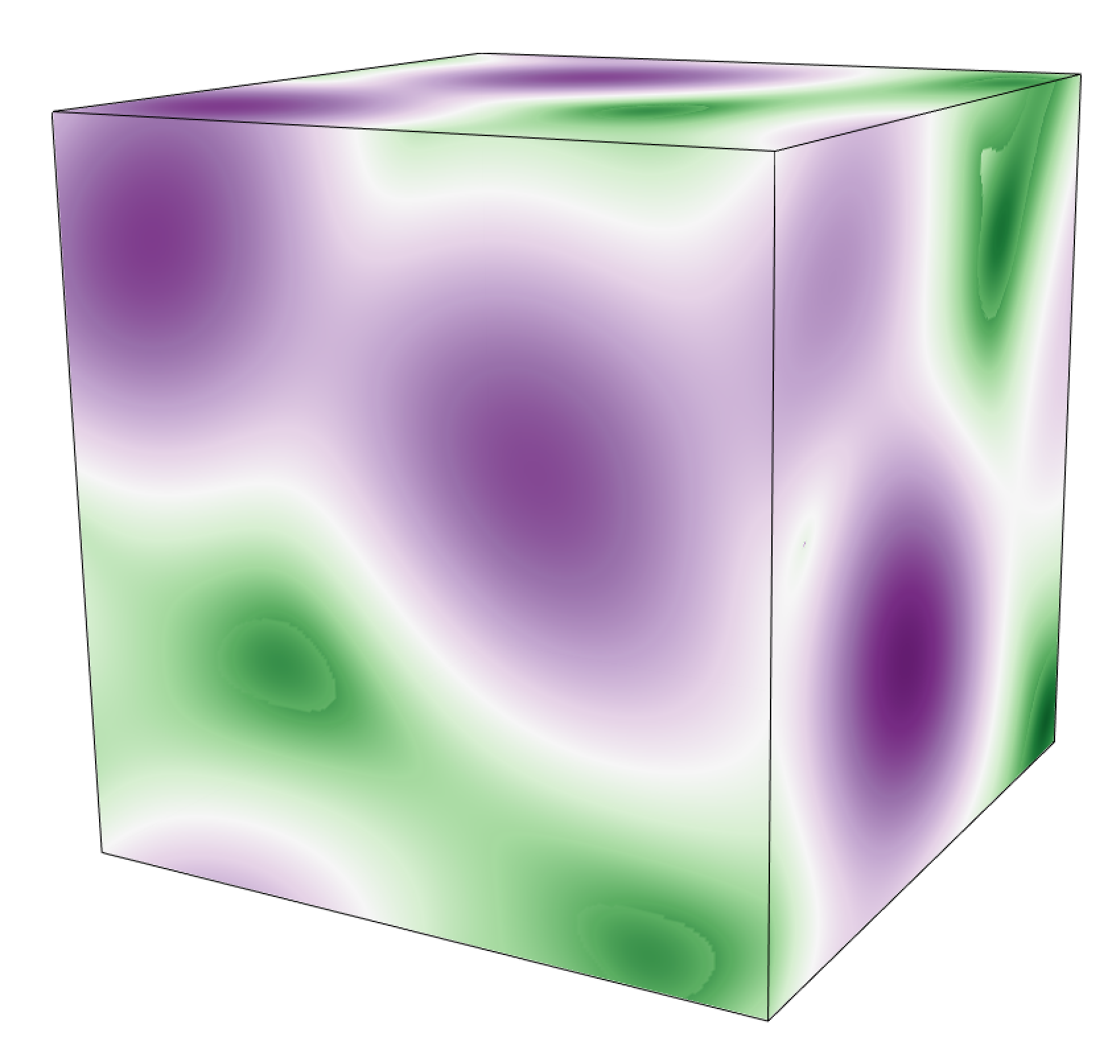
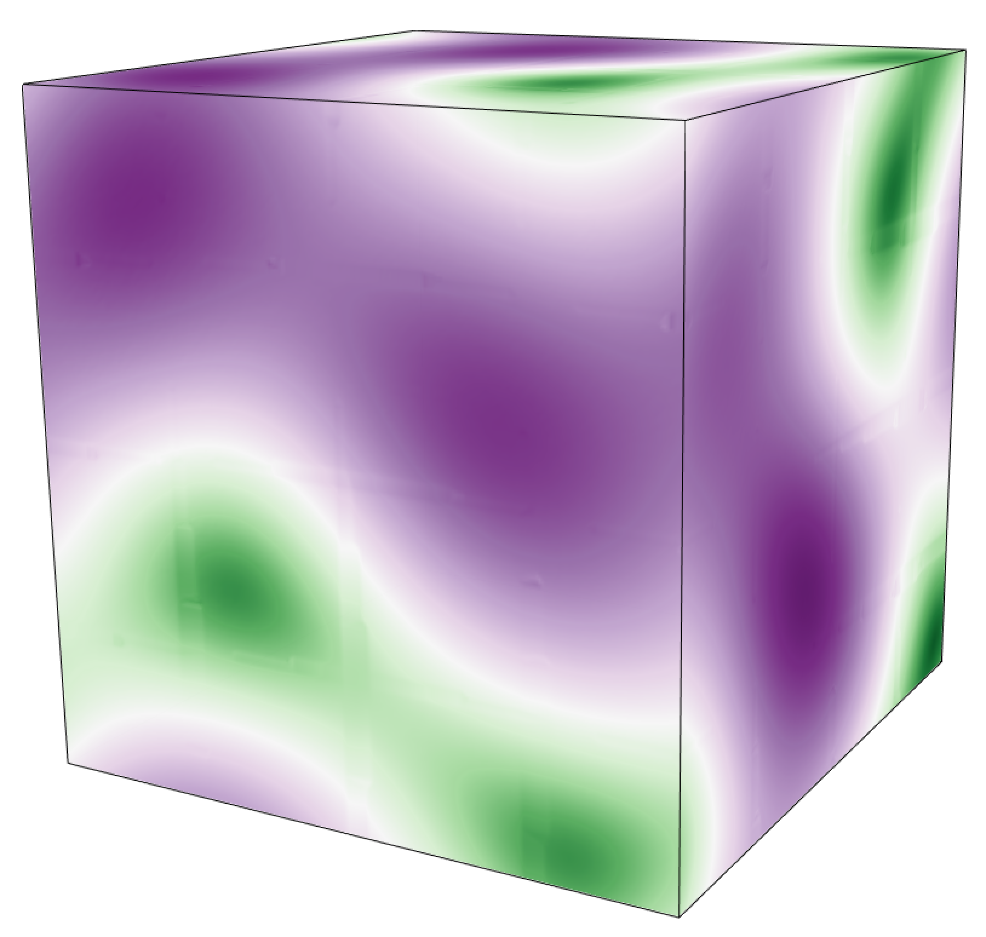
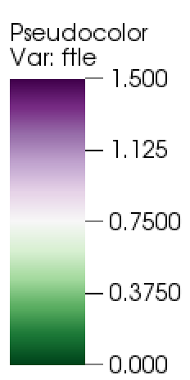
(a) Ground truth, 100 cycles
(b) T6, 1:8, Interval = 100

Slide 10
